Slide 1
DEEPFAKE DETECTION USING DEEP LEARNING
GUIDE NAME : GURUNATHAN M
DR.L.SAIRAMESH ROLL NO : 2019202015
MCA(REGULAR)

Slide 2
MOTIVATION & OBJECTIVES
Deepfakes are videos altered to look other than their original state with the help of Deep Learning.
These Videos are the primary source of false media controversies, propagate misleading news, fake political videos.
The goal of this project is to create a deep learning model with ResNext50 and LSTM to recognize deepfake videos.

Slide 3
INTRODUCTION
Deep Learning is the subfield of Machine Learning
The Concerned algorithms are inspired by the structure and function of brain.
It works with artificial neural networks, which are designed to how humans think and learn.

Slide 4
Literature Review
S.No | Author name & Paper title | Algorithms | Paper details
1 | Author: Yuezun Li, Ming-Ching Chang and Siwei Lyu Title: Exposing AI Created Fake Videos by Detecting Eye Blinking | Algorithm: Viola-Jones type algorithm is used for eye detection. VGG-16 is used for future extraction. LSTM for Video Classification. | State university of New york, Issue: 1 Nov 2018 in arxiv:1811.00656
2 | Author: Aarti Karandikar, Vedita Deshpande, Sanjana Singh, Sayali Nagbhidkar and Saurabh Agrawal Title: Deepfake video detection using Convolutional Neural Network | Algorithm: OpenCV is used for face detection CNN to train the dataset and focus on facial manipulation for detection. | Shri Ramdeobaba College of Engineering and Management. Issue: 2020

Slide 5
Literature Review
S.No | Author name & Paper title | Algorithms | Paper details
3 | Author: Thanh Thi Nguyena, Quoc Viet Hung Nguyenb , Dung Tien Nguyena , Duc Thanh Nguyena, Saeid Nahavandid , Thanh Tam Nguyene , Quoc-Viet Phamf, Cuong M. Nguyeng Title: Deep Learning for Deepfakes Creation and Detection | Algorithm: VGG-19 is used to extract latent features. SVM Classifier is used to detect the result. | School of Information Technology, Deakin University, Victoria, Australia Issue: 2020

Slide 6
Dataset Details
Celebrity Balanced dataset contains 50% real and 50% Fake Videos.
Totally 520 videos present.
https://github.com/yuezunli/celeb-deepfakeforensics

Slide 7
IMPLEMENTATION PLATFORM / FRAMEWORK
PLATFORM
Visual Studio Code
Google Colab
FRAMEWORK
Django

Slide 8
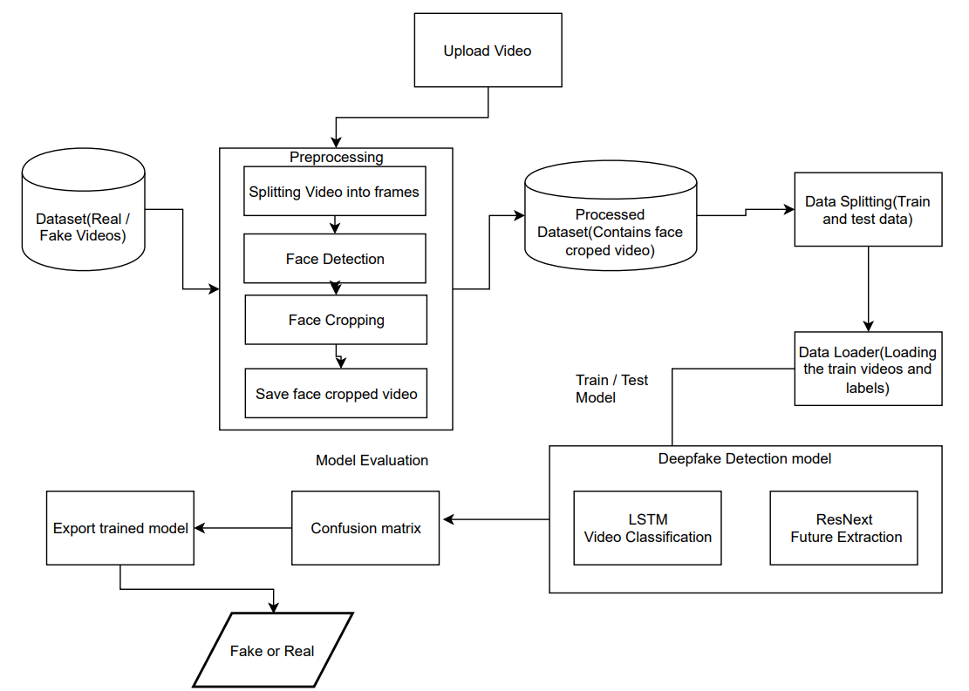
Architecture Diagram:

Slide 9
LIST OF MODULES
Video Preprocessing
Splitting Videos into Frames
Face Detection
Face Cropping
Create Face Cropped Video

Slide 10
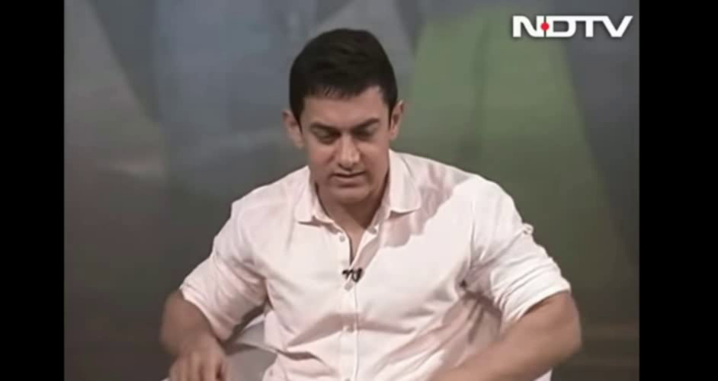
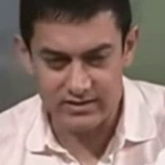
1. Video Preprocessing
Split video into frames
Face Detection
Face Cropping
Input Video
Output Video

Slide 11
2. Feature Extraction
Convert the frame images into tensor based on RGB Colour.
ResNext CNN classifier for accurately detecting the frame level features.
Following, we will be fine-tuning the network by adding extra required layers.
The 2048-dimensional feature vectors after the last pooling layers are then used as the sequential LSTM input.

Slide 12
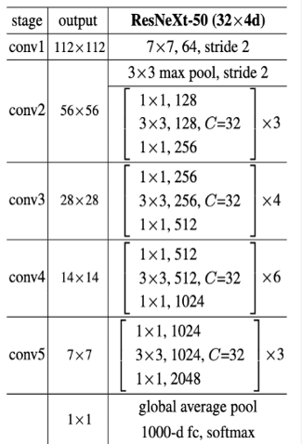
ResNext-50 Architecture
ResNext50 is the Convolutional neural network which is 50 layers deep.
This will take the input image as 112*112 resolution.
Then the image will be processed in all 50 layers.
Output Vector size of the model is 2048.

Slide 13
3. Sequence Processing
ResNext CNN feature vectors of frames as input for the 2048 LSTM unit, which is capable to do achieve our objective.
LSTM is used to process the frames in a sequential manner so that the temporal analysis of the video can be made, by comparing the frame at ‘t’ second with the frame of ‘t-n’ seconds.

Slide 14
Feature Extraction & Sequence Processing
Linear layer
Average Pooling layer
Softmax
LSTM
ResNeXt50
Real
Fake
112*112
Image
2048
Units
2048
Units

Slide 15
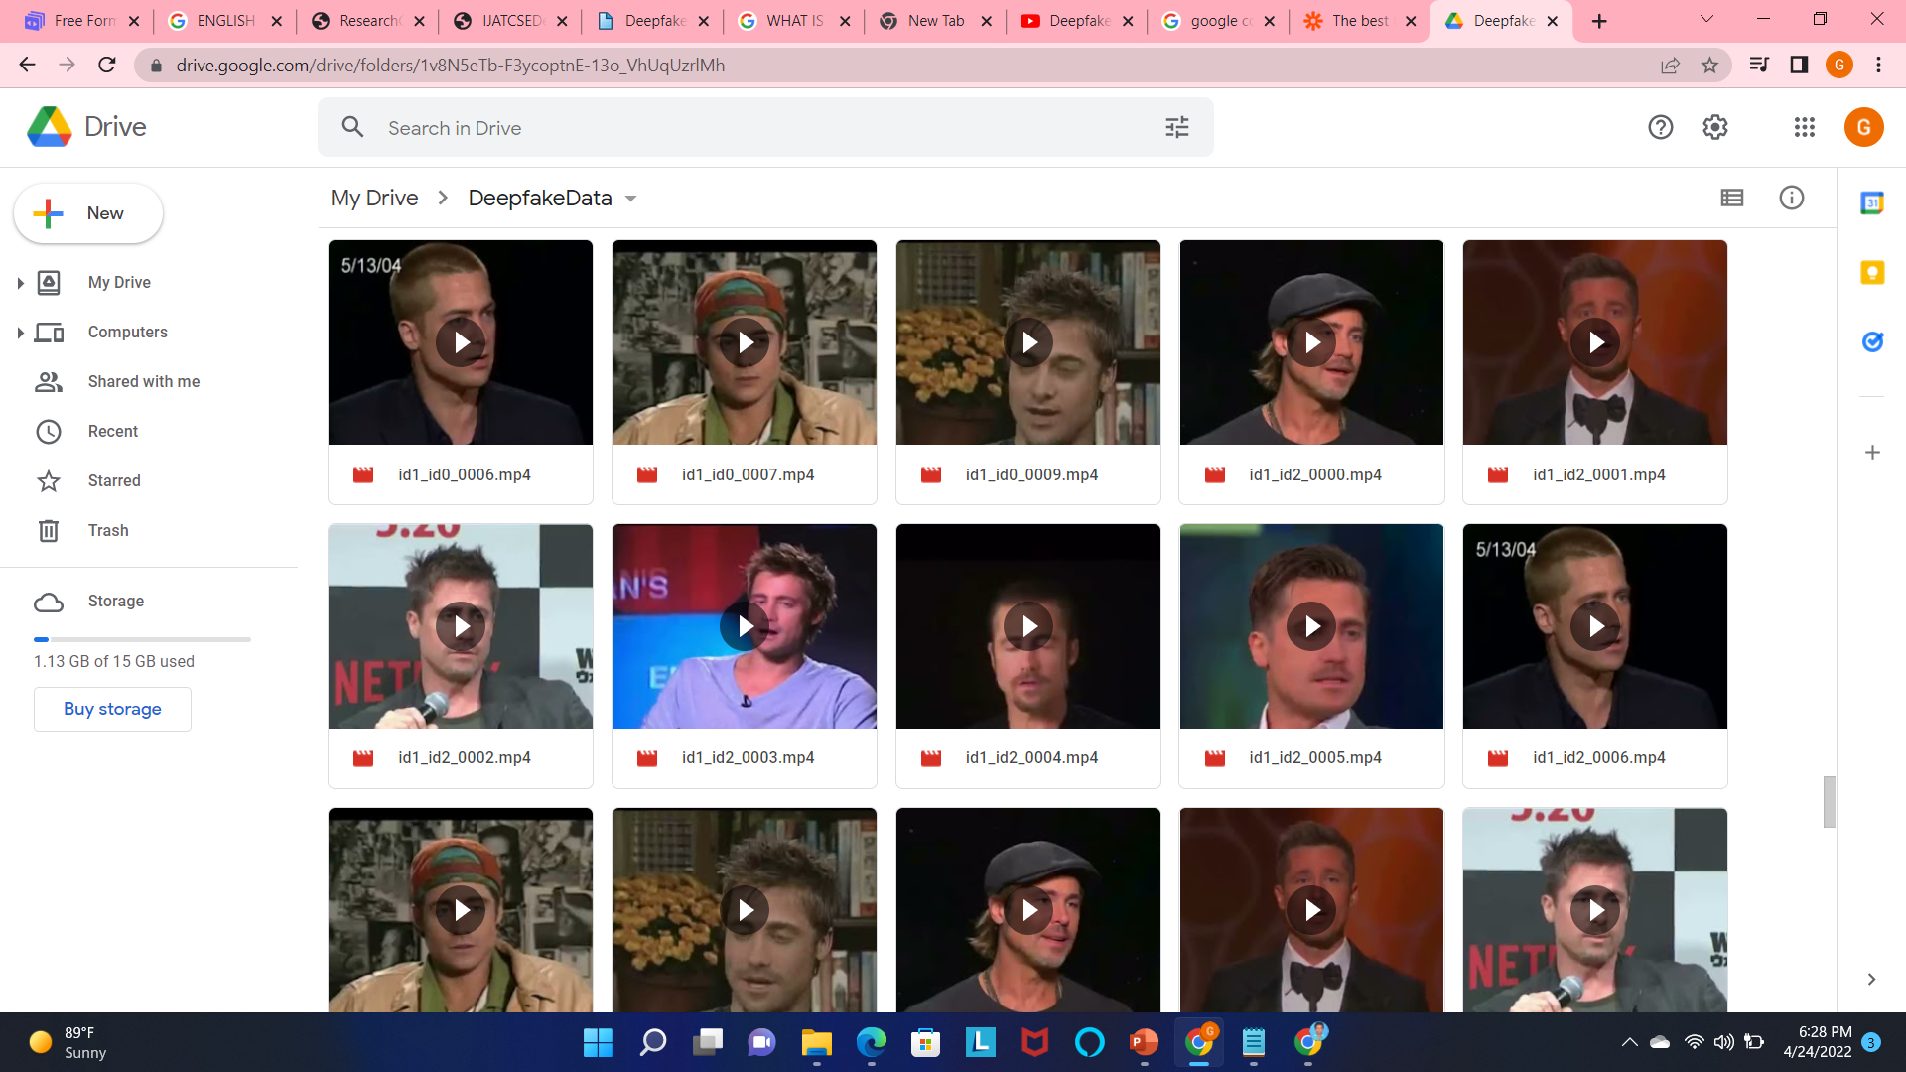
Screenshots

Slide 16
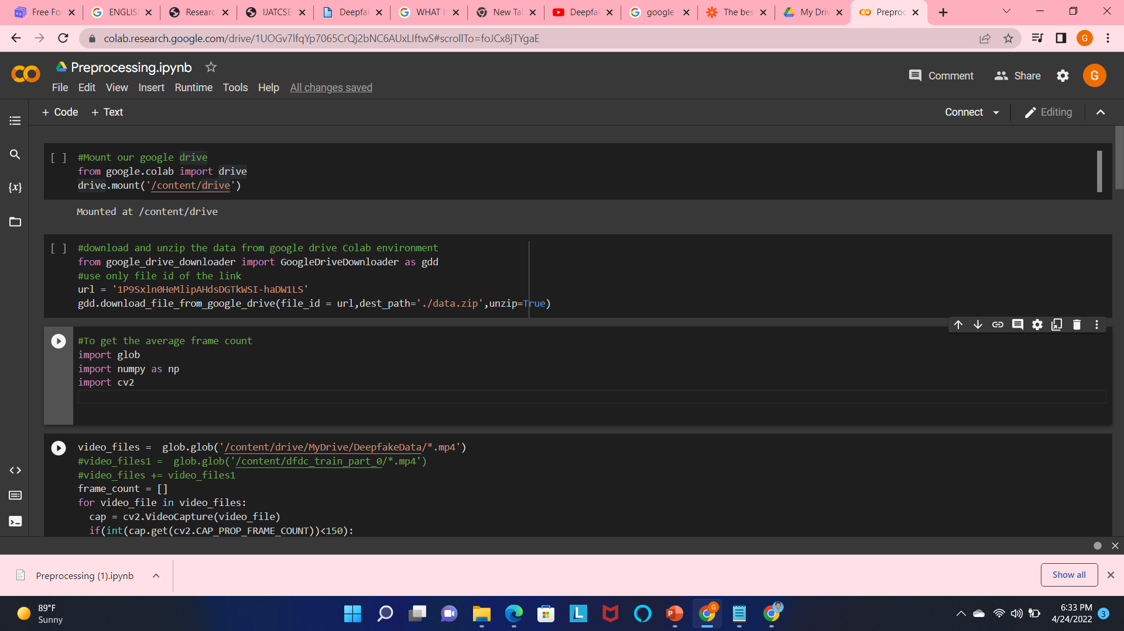
Code Implementation

Slide 17
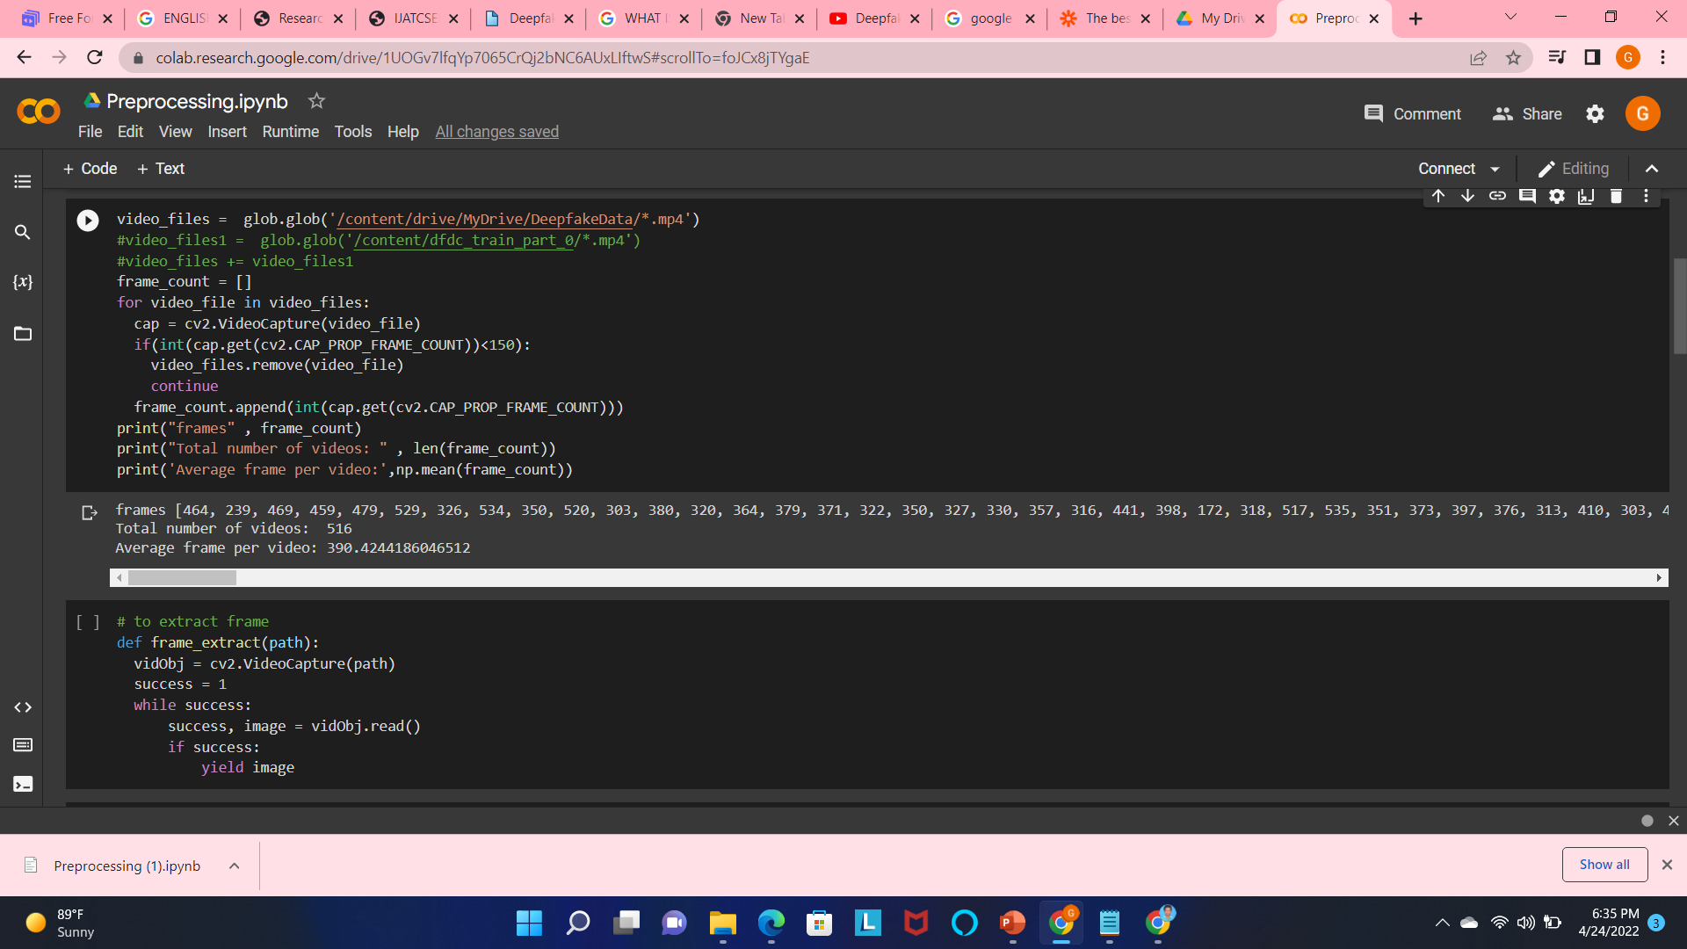
Code Implementation

Slide 18
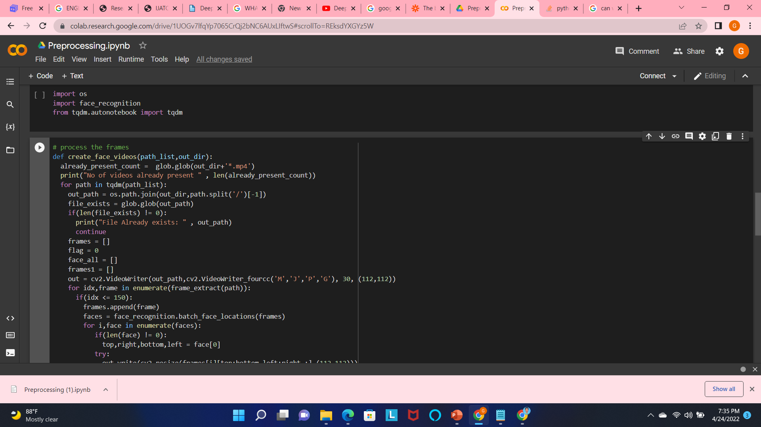
Implementation

Slide 19
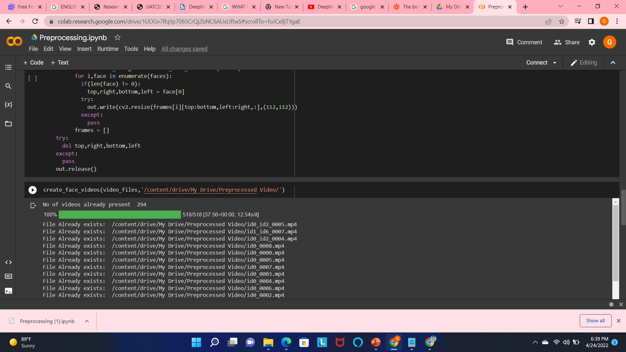
Implementation

Slide 20
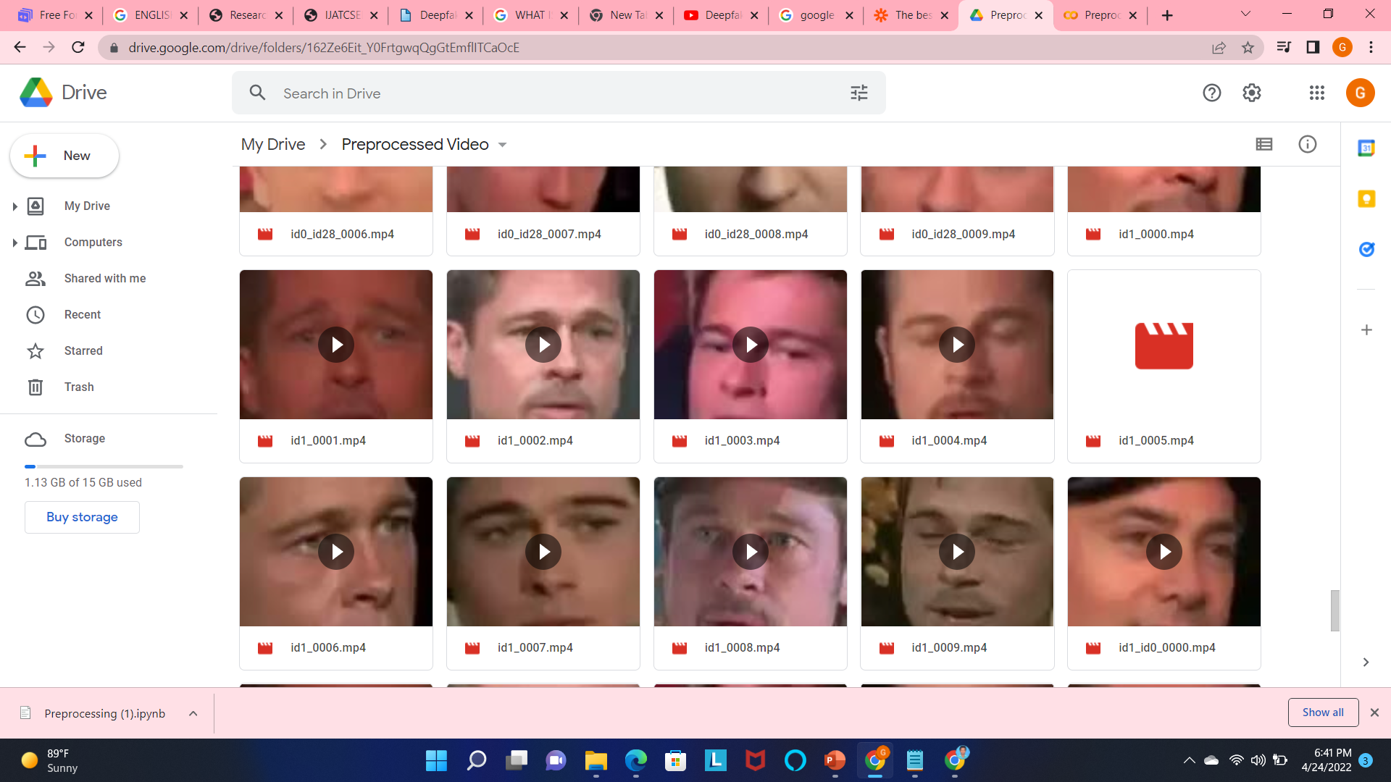
Preprocessed Video

Slide 21
REFERENCES
[1] Yuezun Li, Ming-Ching Chang and Siwei Lyu “Exposing AI
Created Fake Videos by Detecting Eye Blinking” in arxiv.
[2] Aarti Karandikar, Vedita Deshpande, Sanjana Singh, Sayali
Nagbhidkar and Saurabh Agrawal “Deepfake video detection using
Convolutional Neural Network” in IJATCSE, 2020.
[3] EkraamSabir, Jiaxin Cheng, AyushJaiswal, WaelAbdAlmageed,
IacopoMasi, Prem Natarajan , “Recurrent Convolutional Strategies
for Face Manipulation Detection in Videos” in arXiv,2 May 2019.
[4] https://github.com/yuezunli/celeb-deepfakeforensics
[5] https://www.kaggle.com/c/deepfake-detection-challenge/data

Slide 22
THANK YOU

